Slide 1
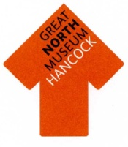
What is Archaeology?

Slide 2
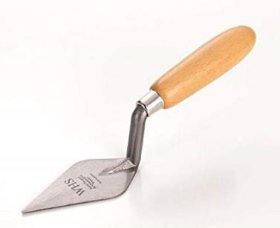
Learning about the past from things people leave behind.
One of the key tools for an archaeologist is a trowel
A model of an excavation in progress

Slide 3
Stratigraphy
Stratigraphy is important to archaeologists.
It is the build up of layers of material under the ground.
The layers of stratigraphy build up on top of each other over time.
The further down the layers are, the older the things that are found within them are.

Slide 4
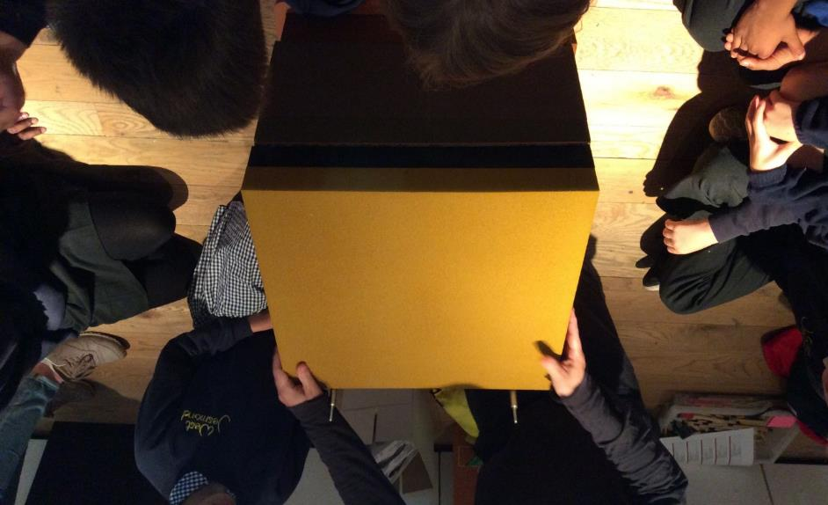
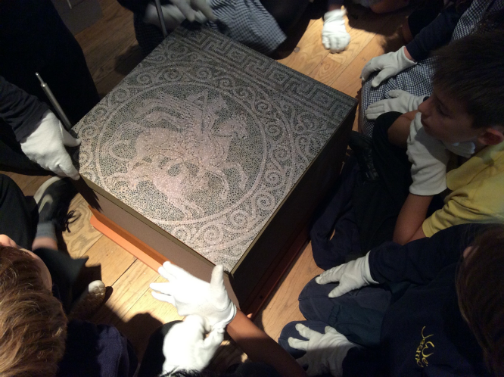
Mini Excavation

Slide 5
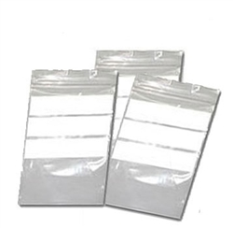
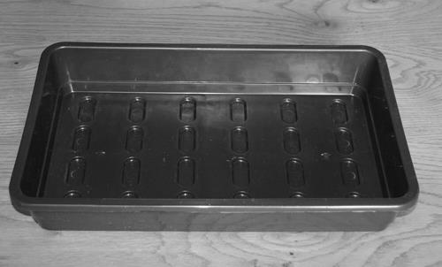
Finds
The find spots of all of the things that archaeologists find are carefully recorded. The finds themselves are placed in bags and trays to be looked at more carefully after the excavation is finished.
Finds Bags
Finds Tray

Slide 6
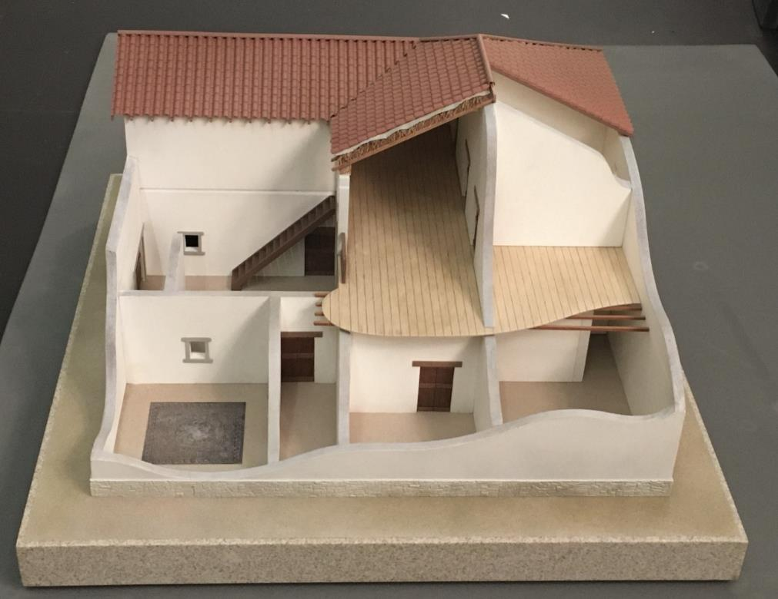
Model of a Greek House

